Slide 1
Why Music?

Slide 2
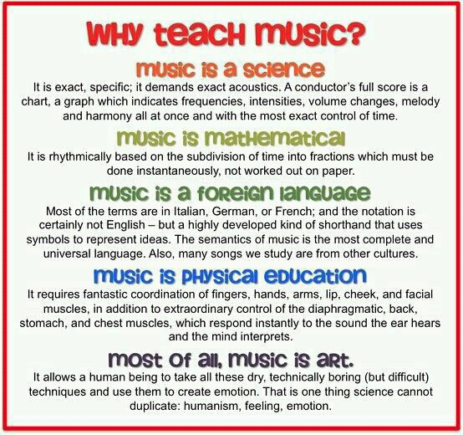

Slide 3
WHY TEACH MUSIC?
It is a SCIENCE
Exact and Specific
Demands Exact Acoustics
Conductors Score is a Chart, a Graph that indicates Frequencies, Intensities, Volume Changes, Melody and Harmony all at once
Most Control Over Time

Slide 4
WHY TEACH MUSIC?
It is MATHEMATICAL
Rhythmically based
Subdivision of Time into Fractions
Done Constantly
Not worked out on Paper

Slide 5
WHY TEACH MUSIC?
It’s a FOREIGN LANGUAGE
Most Terms are Italian, German or French
Notation (not english) – symbols represent ideas
Semantics (meaning) – Complete and Universal
Many songs are of Different Cultures

Slide 6
WHY TEACH MUSIC?
It’s PHYSICAL EDUCATION
Fantastic Coordination – Fingers, hands, Arms, Lips, Cheek, Facial Muscles
Extraordinary control – Diaphragm, Back, Stomach, Chest
ALL Respond Instantly to the Sound that the Ear Hears and Mind Interprets

Slide 7
WHY TEACH MUSIC?
most of all
MUSIC IS ART
Take dry, boring skills and create emotion
One thing science can NOT duplicate:
Humanism
Feeling
Emotion

Slide 8
Expressive
https://www.youtube.com/watch?v=ErMWX--UJZ4
CREATIVE
https://www.youtube.com/watch?v=kNLC8ROAXjI

Slide 12
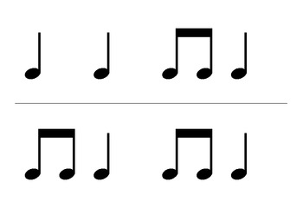

Slide 13
1
1 &

